Slide 1


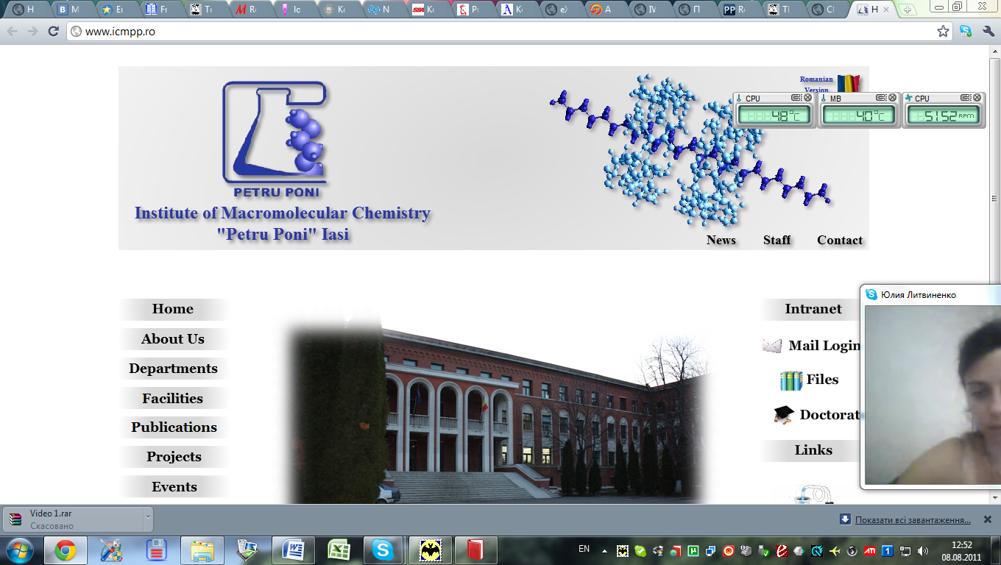


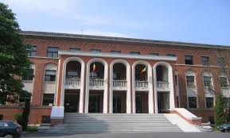
THE 2nd CEEPN WORKSHOP
ON POLYMER SCIENCE
POLYMER SCIENCE – a powerful tool for
highly specialized functional materials
October 24-25, 2014
“Petru Poni” Institute of Macromolecular Chemistry
41A Grigore Ghica Voda Alley, Iasi, Romania
Organized in the frame of the bilateral Romanian-Ukrainian interacademic project entitled “Development of multifunctional organic and organic-inorganic polymeric materials on the base of components with different chemical nature”, 2012-2016.

